Slide 1
Leadership and Organizational Building

Slide 2
Leadership is a Lifelong Journey!
How Can We INSPIRE and ENCOURAGE More People onto
This Journey of Leadership?

Slide 3
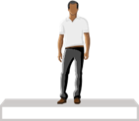
Build on Product and Powered by People
Vertical Marketing Structure
HORIZONtal Marketing Structure
ENCOURAGES TEAMWORK
ALL WORKING TOGETHER
EVERYONE RECEIVES 100% CREDIT FOR SALES AND VOLUME GENERATED
EARNING POTENTIAL IS NOT DETERMINED BY POSITION
REAL ESTATE, INSURANCE, SALES, TRADITIONAL BUSINESS
ALL IN COMPETITION

Slide 4
Management vs. Leadership
Static vs. Dynamic

Slide 5
Leaders are Readers
Equipped with Universal Principles

Slide 6
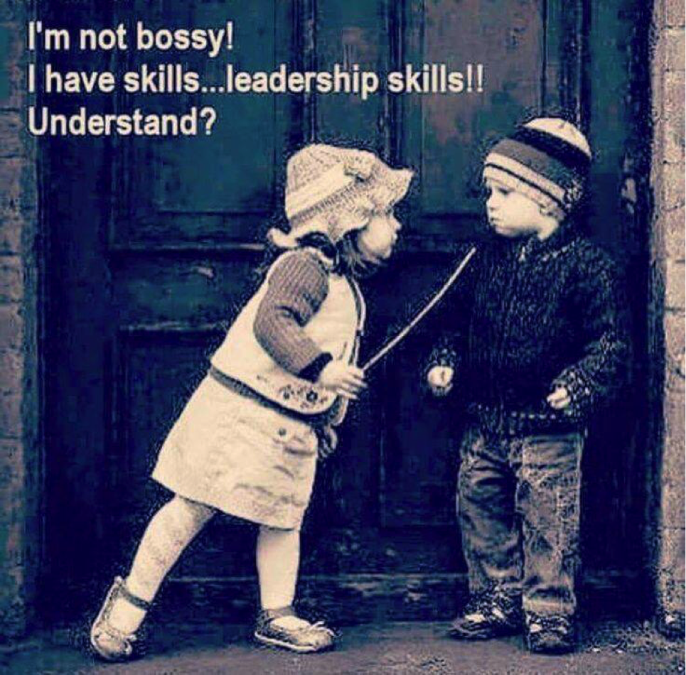
Is Leadership Style Important?

Slide 7
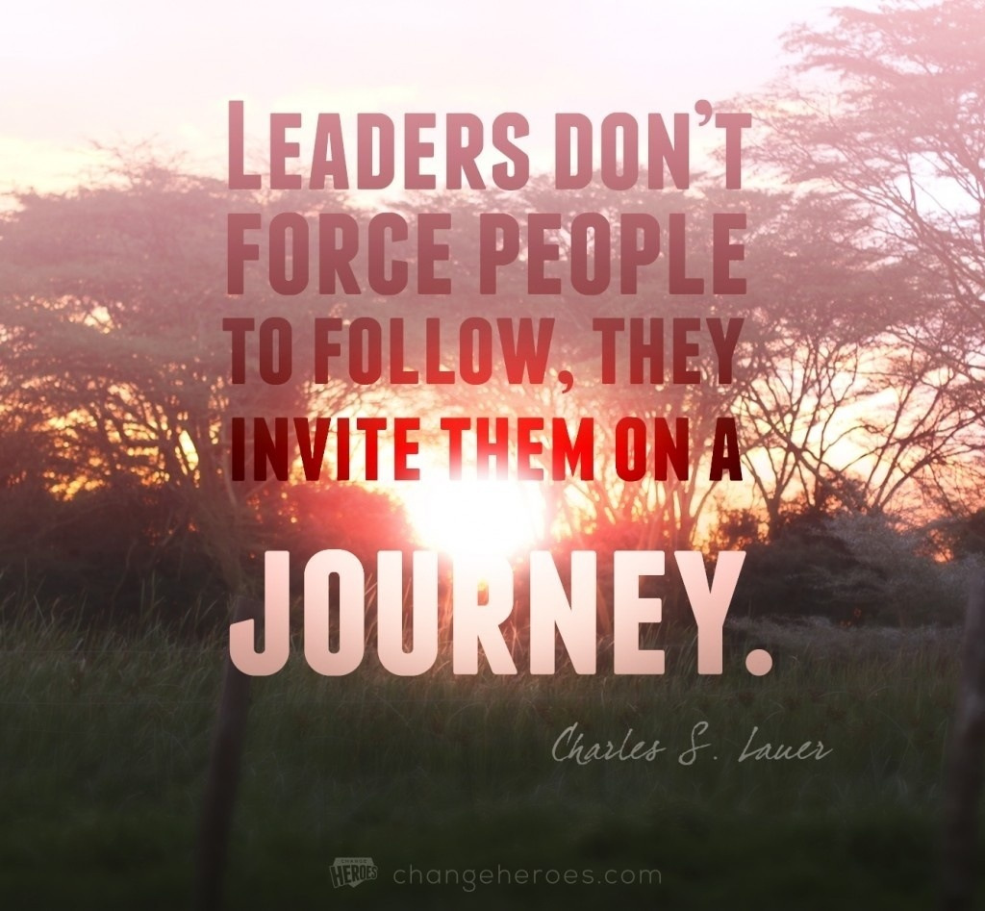
Can You Lead People of Different Styles (Personalities)?

Slide 8
Good Leaders Do Not Lead Everyone the Same Way
Not everyone is ready to lead; and
Not everyone is even ready to follow
Customized or individualized leadership is an art to master!
Accepting people where they are then taking them somewhere

Slide 9
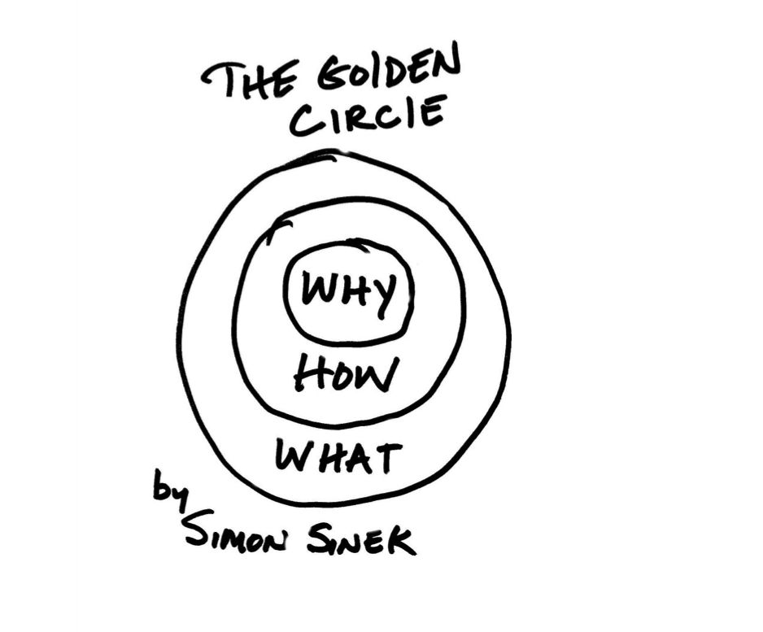
UFOs were sold on Entrepreneurship and Freedoms!

Slide 10
If We Want to Experience the Power of:
Leverage
Compounding Effect
Residual Ongoing Income
We Have to Keep People in the Business
Until They See the Light!

Slide 11
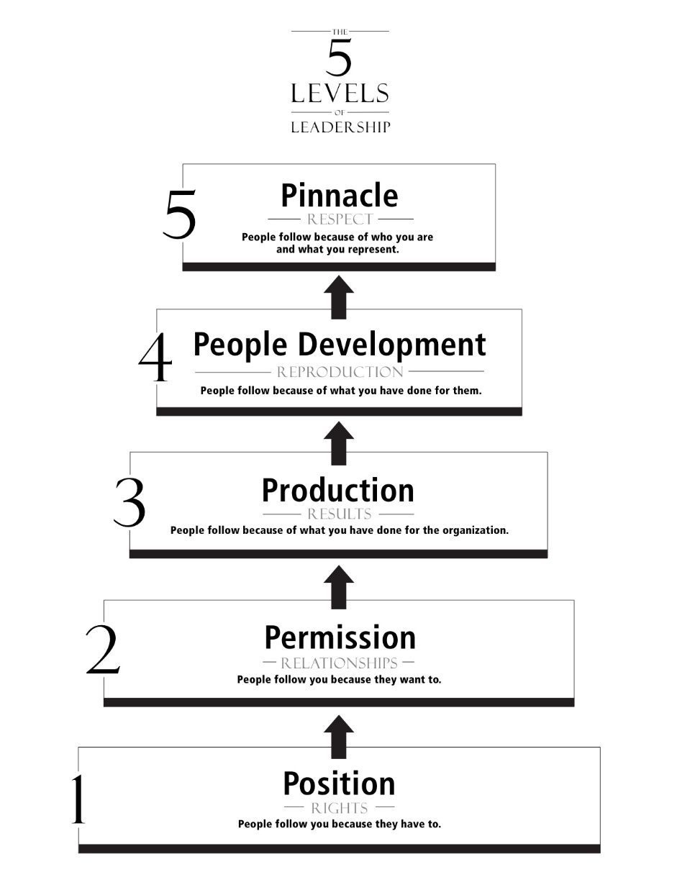
People Don’t Quit On Business People Quit On People
Practice vs. Principles
Lead without Authority

Slide 12
Leadership Duplication is like Teaching People Become Better Drivers
UnFranchise® is the best vehicle for entrepreneurs to become financially independent, but
We still have to develop the mindset of successful entrepreneurs and pioneers , and
We still have to become better drivers for this vehicle!

Slide 13
Building and Duplication with Results Producing Events
Be a Product of the Product
Learn How to Show the Plan
Master UnFranchise® Owner
Shopping Annuity® Bonus Program Achiever
Embrace, Leverage and Support GMTSS

Slide 14
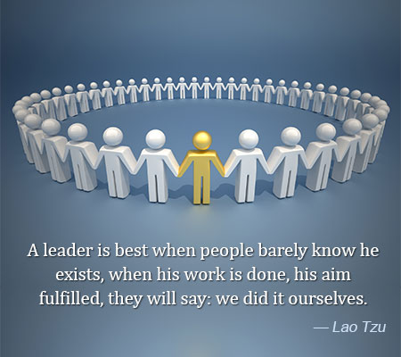
Ancient Chinese Philosopher Lao Tzu on Leadership

Slide 15
The Journey of Developing Leadership
一个团队一个梦
感恩不忘初衷
不懈的努力
精益求精
吸引力
自律
信
One Team One Dream
Gratitude and Humility
Reverse Pyramid
Tireless Efforts
Ever-Improving
Attraction
Self Discipline
Belief

Slide 16
We Are the Pioneers to Create Our Own Global Economy!

